Slide 1
Final year project management system
Supervisor: Ridah Fatima Mudassir
Group members:
Walid Ahmed(12422)
Muhammad Sami Ullah Qureshi(12520)
Alizain Aziz(12253)

Slide 2
introduction
Final Year Project Managements system follows complete final year project’s life cycle.
It is automation of manual tasks in FYP. It maintains Project repository and their documents. It handles Notifications and deadlines. It is fully automated system with online availability. It will also maintain student and supervisor meeting logs.

Slide 3
Objectives
To develop management software that keeps track and repository of all projects and manages all the processes involved in projects.
To manages current and previous final year projects.
To handle the communication gap between the student groups and supervisor.
To provide the platform for the coordinator so all the activities can be handle on the same platform.

Slide 4
Functional requirements
Repository will contain all project.
Student can make a new group or join an existing group.
Student will be able to choose from available list of supervisors.
Student will be able to upload different artifacts of their projects.
Student will drop the deliverables.
Supervisor will choose groups to supervise from his request list.
Supervisor will be able to schedule meetings with students.
Supervisor will add meeting logs with students to the system.
Coordinator will create a new batch or manage existing created batch.
Coordinator will register students to the batch.
Coordinator will manage already created groups or create groups of students who are not with any group.
Coordinator will set deadlines to deliver different artifacts of projects
Coordinator will generate different notifications related to the FYP and these notifications will be sent to all students.
Coordinator will be able to send emails to all the users of the system.
Coordinator will register new faculty or manage existing faculty and set their roles.
Will set the configuration of each group.
Will manage repository.

Slide 5
Non-Functional requirements
The system is available online except in the case of unexpected condition like failure of internet etc.
System is user friendly, responsive and it is designed so that interaction of user will be maintained.
Since this system is responsive so users will be able to access from every device with internet connections.
Our system is adaptive to future changes. Users can be added or removed. Records can be edited also.
To avoid failure, we will use server validation using PHP and JavaScript validation on client side.
To ensure consistency we are using same CSS style sheets on almost all pages.

Slide 6
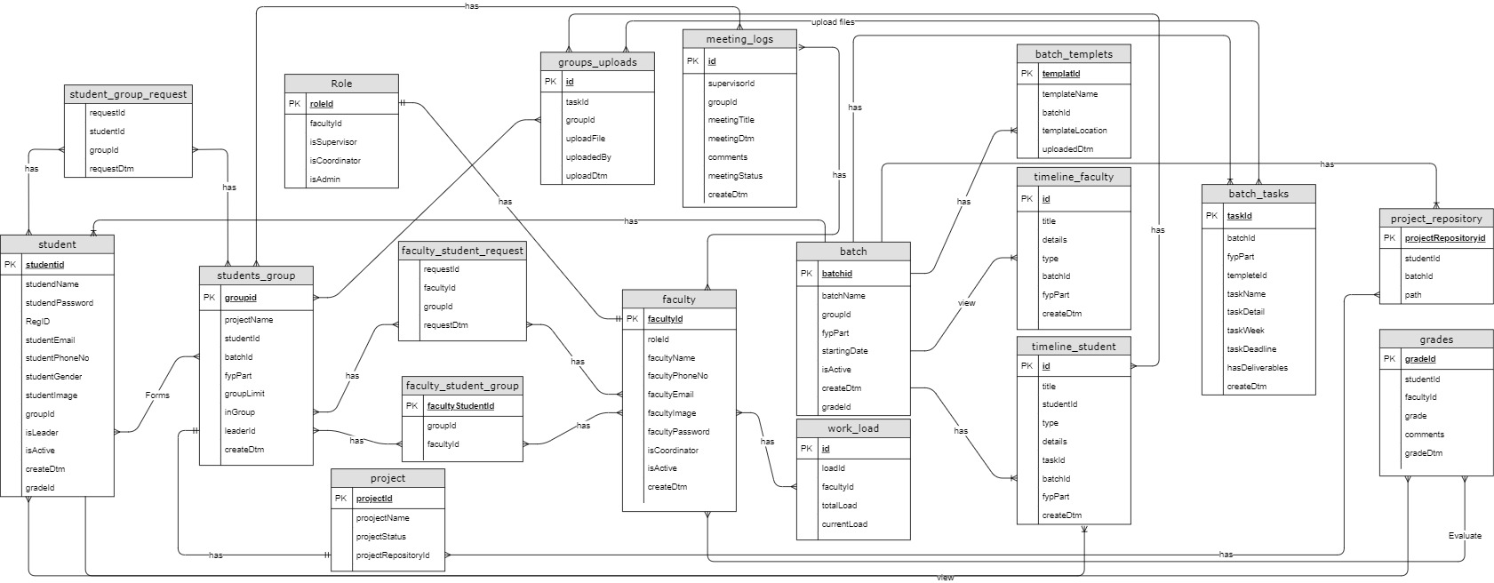
Entity relationship diagram

Slide 7
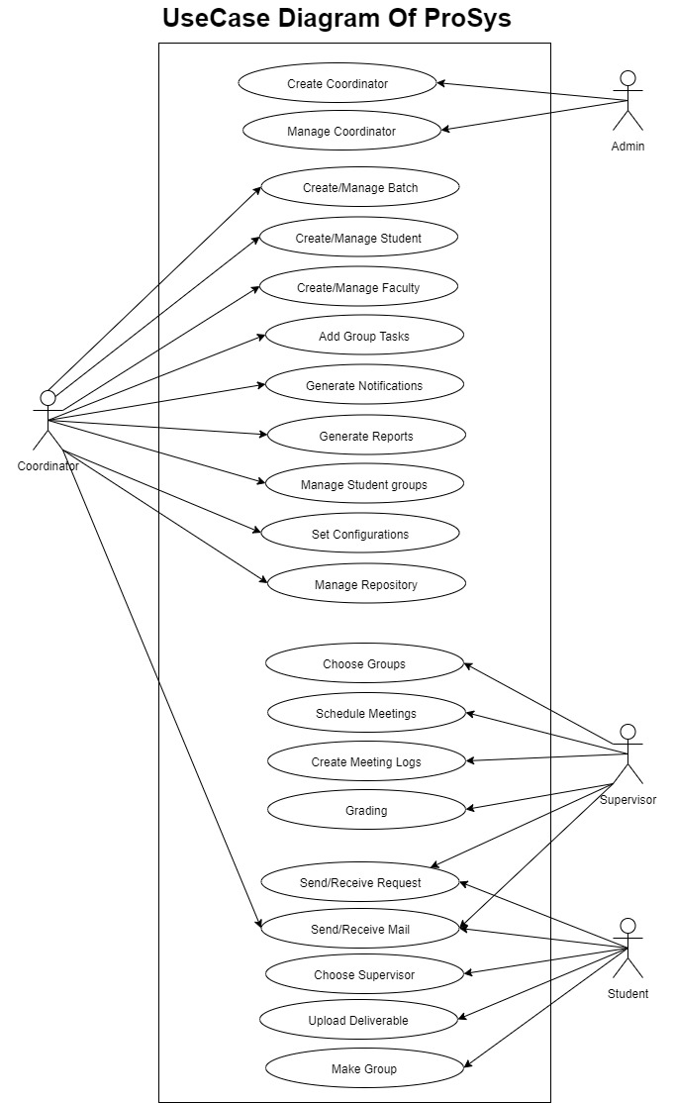
Use Case Diagram

Slide 8
S. No. | Elapsed time since start of the project | Milestone | Deliverable
1. | Week 01 – 04 | Group formation, Selection of an Idea, Approval of an Idea , research of approved idea. | Project Proposal Form.
2. | Week 05 – 08 | Functional and non-Functional requirements | Functional and non-Functional requirements Document.
3. | Week 09 – 12 | Use Case Diagram, Entity relationship Diagram. | Use Case diagram and ERD document.
4. | Week 13 – 16 | Logical schema of ERD, UI diagram. | ERD and UI Diagram.
5. | Week 17 – 20 | Login Form, Admin Dashboard, Profile Setting, Update Profile, Change Password. Create Coordinator and manage Coordinator. | Login and Admin Panel.
6. | Week 25 – 24 | Coordinator Dashboard. Batch, create batch, batch task, batch template. Register user: Student, Supervisor. | Coordinator panel.
7. | Week 25 – 28 | Manage Timeline: Student and Faculty timeline. Grade. View: No of students, no of batch, no of projects. Approved project. | Coordinator panel.
8. | Week 29 – 32 | Supervisor dashboard. Approved/delete supervised request. Manage Meeting Log. Manage Student Timeline. Grade. | Supervisor Panel.
9. | Week 37 – 36 | Student Dashboard. Student timeline. Create Projects, update project details. Send request group, approved/decline request. Upload files. | Student panel.
10. | Week 37 – 40 | Email: Inbox and sent box. | Email.

Slide 9
Conclusion
Final year project management system is a must need for every university by which project repository can be maintain.
Also help in managing of FYP life cycle on the platform.

Slide 10
Thank you

